Slide 1
\

Slide 2
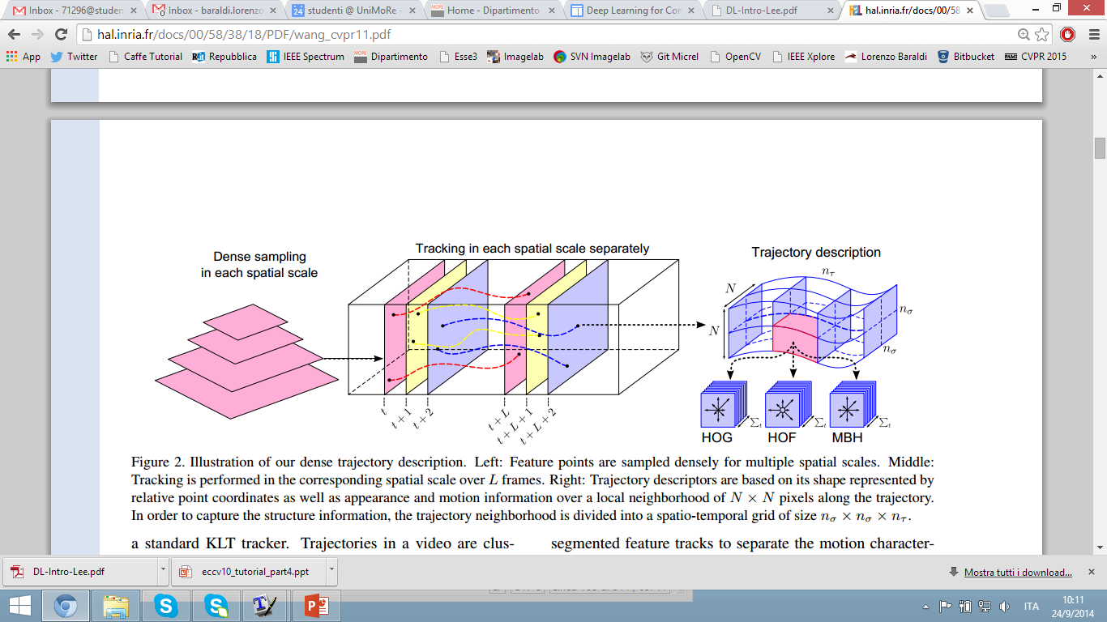
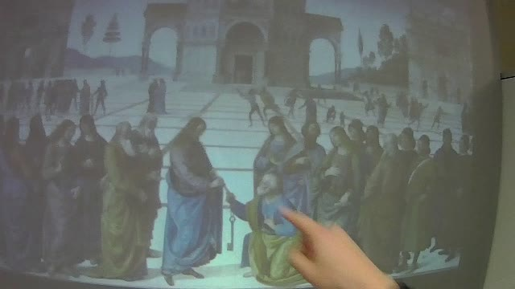
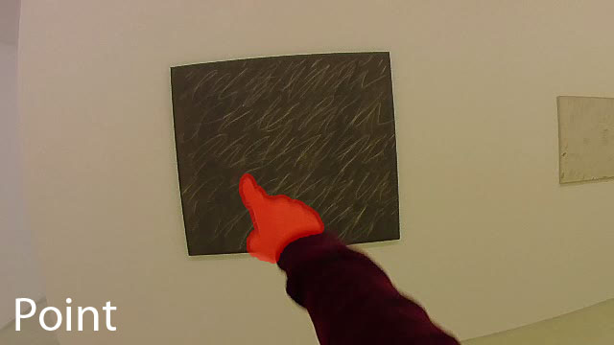
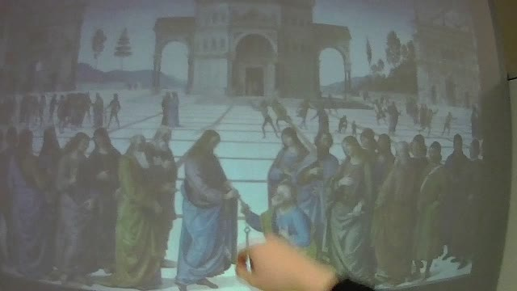
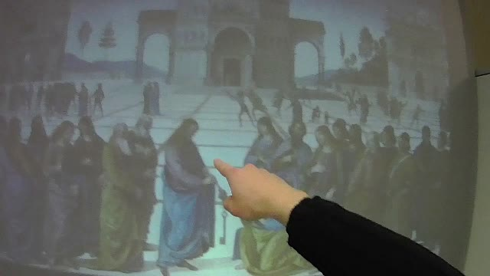
THE TRADITIONAL RECOGNITION APPROACH
Input data
Feature representation
Learning algorithm
BoW of Spatio-temporal features extracted around trajectories
Linear SVM or Struct SVM
Frame sequence

Slide 3
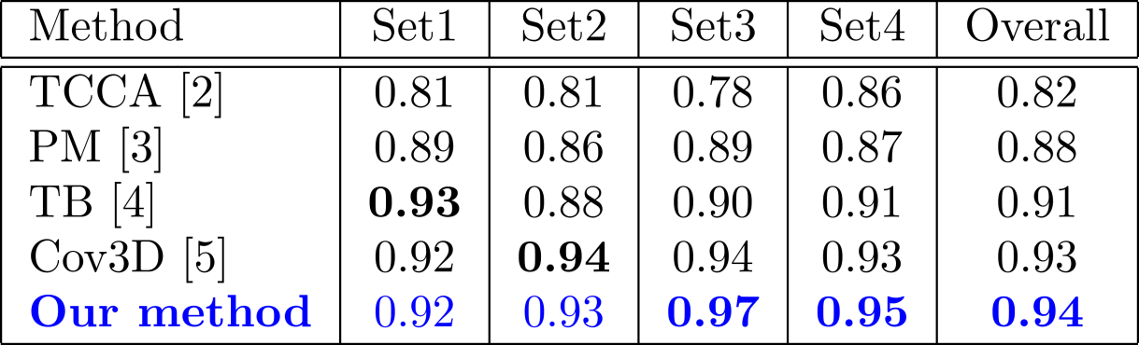
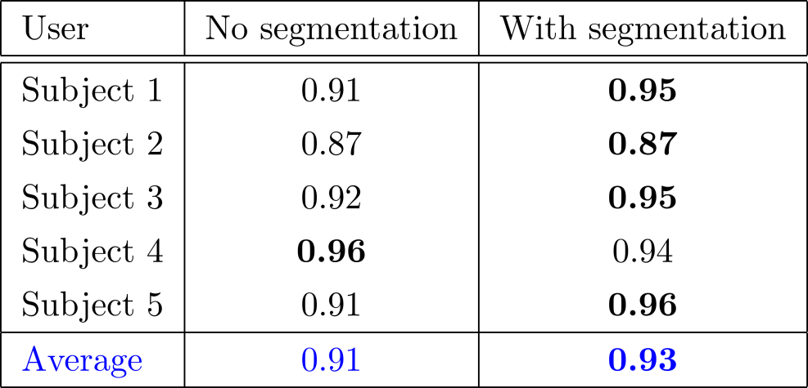
EXPERIMENTAL EVALUATION
Cambridge Gesture DB
Interactive Museum Dataset
using only two samples per class for training
[2] T.-K. Kim and R. Cipolla. Canonical correlation analysis of video volume tensors for action categorization and detection. Trans. PAMI, 2009 [3] Y. M. Lui, J. R. Beveridge, and M. Kirby. Action classification on product manifolds. In Proc. of CVPR, 2010 [4] Y. M. Lui and J. R. Beveridge. Tangent bundle for human action recognition. In In proc. of Automatic Face & Gesture Recognition and Workshops, 2011 [5] A. Sanin, C. Sanderson, M. T. Harandi, and B. C. Lovell. Spatio-temporal covariance descriptors for action and gesture recognition. In Proc. of Workshop on Applications of Computer Vision, 2013.

Slide 4
A SEQUENTIAL VERSION

Slide 5
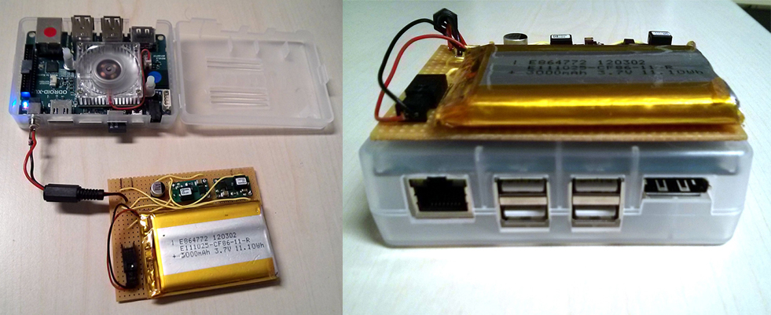
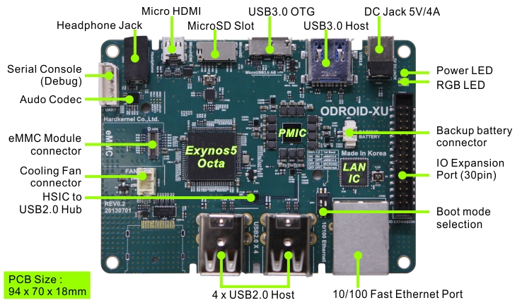
IMPLEMENTATION
The proposed algorithms have been implemented on the Odroid XU developer board:
Big.LITTLE architecture hosting Cortex-A15 and Cortex-A7 CPUs
Custom designed battery pack
A naive OpenCV implementation would run at ~2 fps
We added several low-level optimizations (compiler optimizations and Neon Intrinsics) and multi-threading with OpenMP
Runs at ~10 fps

Slide 6
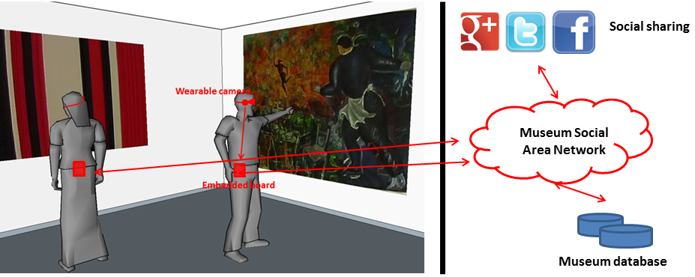
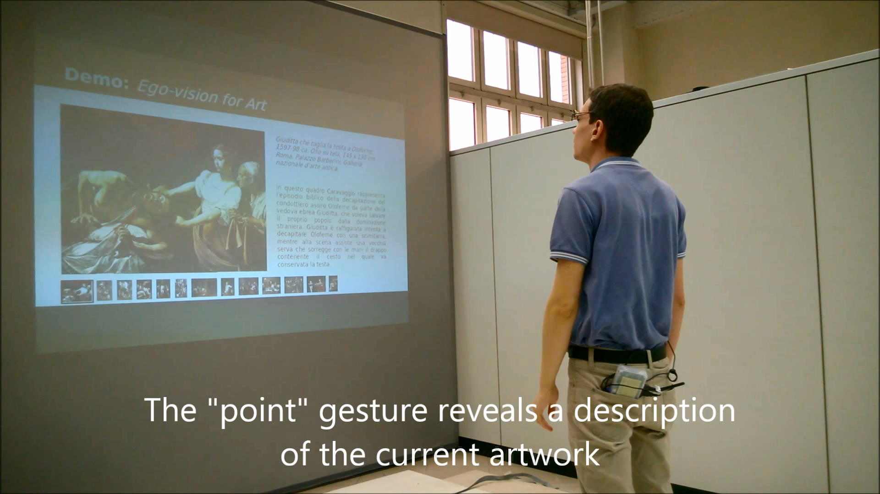
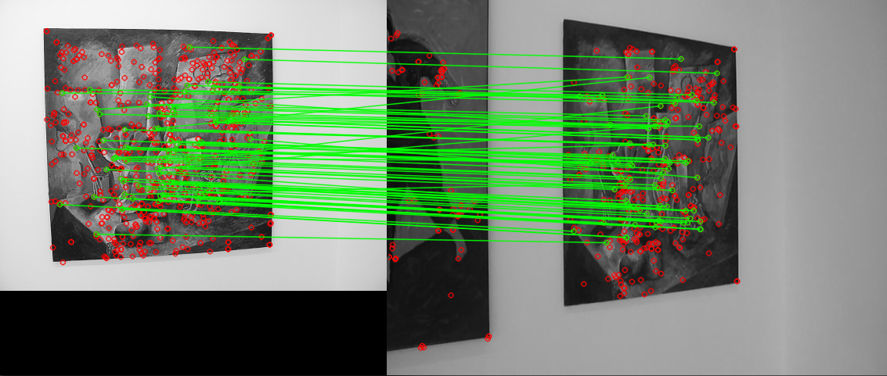
Applications
Personal devices for cultural heritage
Ask information about monuments and artworks
Artwork recognition
GPS for localization
Headphones
New HCIs based on gestures
Gesture recognition is enterely performed on the board
Connected wirelessly with a projector (MPI + WiFi)

Slide 7
PUBLICATIONS
Currently under review:
Gesture Recognition using Wearable Vision Sensors to Enhance Visitors’ Museum Experiences L. Baraldi, F. Paci, G. Serra, L. Benini, R. Cucchiara accepted with mandatory modifications to IEEE Sensors Journal
Interacting with Art: Ego-vision for Enriched Cultural Experience L. Baraldi, S. Alletto, G. Serra, R. Cucchiara submitted to Machine Vision and Applications
Conference papers:
Gesture Recognition in Ego-Centric Videos using Dense Trajectories and Hand Segmentation L. Baraldi, F. Paci, G. Serra, L. Benini, R. Cucchiara IEEE Computer Vision and Pattern Recognition (CVPR) Embedded Vision Workshop (EVW), 2014
Hand Segmentation and Gesture Recognition in EGO-Vision G. Serra, M. Camurri, L. Baraldi, M. Benedetti, R. Cucchiara in Proc. of ACM Multimedia International Workshop on Interactive Multimedia on Mobile and Portable Devices (IMMPD), 2013

Slide 8
THANKS!

